Slide 1

Planning
Simply the planning is looking forward before getting things done. It is the basic function of management by which we use to select our goals and objectives and make plans to achieve them. Planning basically related to the 5WH question and systematic process of formulating the answer.
5WH= What, Where, When, Who, Why and How Should be done?

Slide 2

Planning involves setting organizational goals, defining strategies to achieve those goals, and outlining the necessary actions and resources required to implement those strategies
Managerial Function
Goal-Oriented
Futuristic
Systematic process
Contingency Planning
Intellectual Process
Characteristic / Feature of Planning
Feedback and Monitoring
Pervasive
Accountability
Rational Approach
Decision-Making
Continuous Activities
Comprehensive

Slide 3
Managerial function: Planning is a first and foremost managerial function provides the base for other functions of the management, i.e. organising, staffing, directing and controlling, as they are performed within the periphery of the plans made.
Goal oriented: It focuses on defining the goals of the organisation, identifying alternative courses of action and deciding the appropriate action plan, which is to be undertaken for reaching the goals.
Pervasive: It is pervasive in the sense that it is present in all the segments and is required at all the levels of the organisation. Although the scope of planning varies at different levels and departments.
Continuous Process: Plans are made for a specific term, say for a month, quarter, year and so on. Once that period is over, new plans are drawn, considering the organisation’s present and future requirements and conditions. Therefore, it is an ongoing process, as the plans are framed, executed and followed by another plan.
Intellectual Process: It is a mental exercise at it involves the application of mind, to think, forecast, imagine intelligently and innovate etc.

Slide 4
Futuristic: In the process of planning we take a sneak peek of the future. It encompasses looking into the future, to analyse and predict it so that the organisation can face future challenges effectively.
Decision making: Decisions are made regarding the choice of alternative courses of action that can be undertaken to reach the goal. The alternative chosen should be best among all, with the least number of the negative and highest number of positive outcomes.
Systematic Process: Planning follows a structured and systematic process that includes steps such as goal setting, data collection and analysis, strategy development, action planning, and implementation.
Rational Approach: Planning is often based on a logical and rational approach. It relies on data, analysis, and sound judgment to determine the best course of action.
Comprehensive: Planning can encompass various aspects of an organization or individual's life, including financial, operational, marketing, and strategic planning. It considers multiple dimensions.

Slide 5
Accountability: Individuals or teams responsible for implementing the plan are held accountable for their actions and the outcomes. This encourages responsibility and commitment.
Feedback and Monitoring: Effective planning includes monitoring progress and gathering feedback to assess whether the plan is on track and to make adjustments as needed.
Contingency Planning: Recognizing that not everything will go as planned, contingency planning involves preparing for potential risks and challenges that may arise.

Slide 6
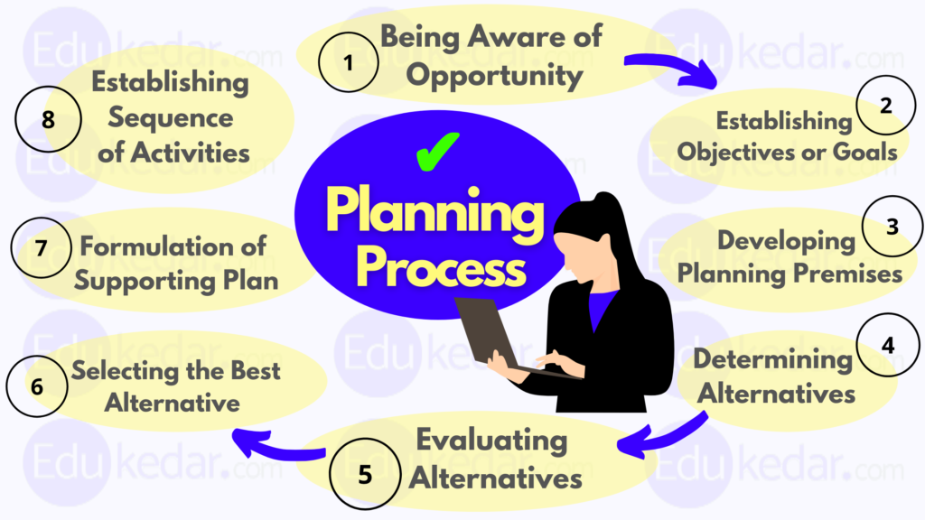
Process of Planning

Slide 7
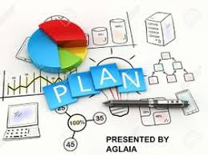
Types of plan
On the basis of Hierarchy
On The Basis Of Use
On The Basis Of Flexibility
On The Basis Of Time
Corporate /Strategic plan
Tactical plan
Operational plan
Long term Plan
Intermediate plan
Short term Plan
Specific Plan
Flexible plan
Single plan
Standing plan

Slide 8
Corporate/ Strategic Planning
Strategy=A detailed plan for achieving success in situations such as war, politics, business, industry, or sport, or the skill of planning for such situations ( Cambridge Dictionary )
. Strategic Planning is major aspect of managements, that concerned with long term business planning for company’s customers services and achieving the organizational goal in the competitive market. It is set by top level of management.
Operations Strategy mainly focus on three things:
Ensuring the quality
Improvement of Customers Experiences
Ensuring the reliability
Environmental Acceptance

Slide 9
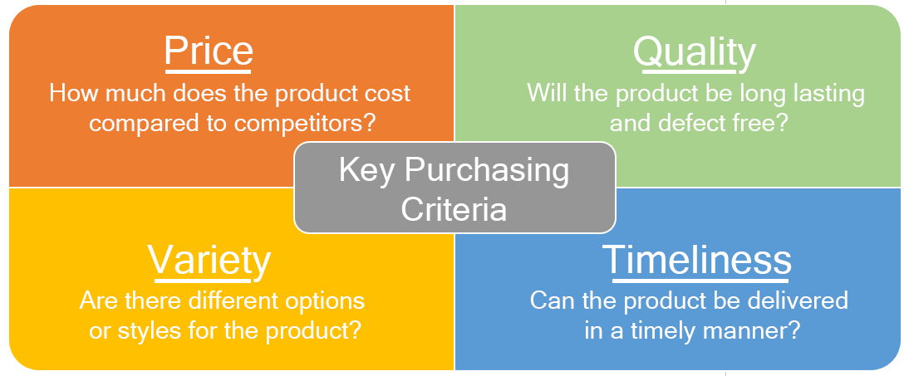
Strategic planning as competitive weapon
This is the age of globalization and this new era of the world has enabled firms to specialize and to increase the intensity of R&D, innovation and capital in their output. if any company wants to be world class and take advantages of this age of globalization Strategic planning is often used as the most potent competitive weapon.
Reliability/Dependability
Accordance with promises made to customers
Competitive dimensions of and organization

Slide 10
Operation Planning/ Tactical planning
Tactical planning is a type of planning that involves breaking down a long-term strategic plan into smaller and more distinct short-term plans. Companies and teams frequently use this type of plan when they have long-term goals that extend further than two or three years.
An operational plan (also known as a work plan) is a highly detailed outline of what your department will focus on for the near future—usually the upcoming year. The plan will answer questions - who, what, when, and how much - regarding daily or weekly tasks.
An operational plan helps you identify areas that are not generating enough revenue or are causing losses, and then assists you with formulating the necessary changes
Operation / Tactical plan= 4p²+6σ

Slide 11
Tools for Planning
A strategy is a plan which decides how the goals can be achieved through the available resources. Strategy planning tools is a process through which one plans and develops tactics, action plans, and policies; to utilize the available resources to the fullest and to make the best and appropriate decisions. Strategy planning tools are essential tools for effective and efficient management. Strategic planning tools are a process that includes inputs, activities, output, and outcomes.
Qualitative tools for planning:
SWOT Analysis
Porter’s 5 Forces
3. PESTLEG Analysis
4. Visioning
5. VRIO Framework( Value, Rareness, Imitability, Organization)
5. MBO
6. Benchmarking

Slide 12
SWOT Analysis
SWOT analysis is a strategic planning tool that helps build an effective marketing plan. It is a part of the strategic marketing process , which helps analyse your present market position and further helps build a strong business plan.
It uses the data from the analysis of the market, customer, and competitors to develop a framework to represent your SWOT parameters: Strengths, Weaknesses, Opportunities, and Threats. It also helps when you need a fresh look at your strategies.
SWOT analysis (Strengths, Weaknesses, Opportunities, Threats) is a tactic businesses use to evaluate their market position. As the abbreviation suggests, it is a framework that helps identify your strengths and weaknesses as well as the opportunities and threats apparent in your industry.
Conducting a SWOT analysis helps you stay informed about the changing dynamics of your market position. The four aspects of this framework assess both internal and external factors that impact your growth.
The internal factors are strengths and weaknesses, while external factors are opportunities and threats. Conducting a SWOT analysis helps you identify and modify the internal factors and stay aware and attentive of the external factors.

Slide 13
Porter’s Five Forces Model
Porter's Five Forces is a tool for understanding the competitiveness of your business environment.
The five forces are: competitive rivalry, new entrants, power of buyers, power of suppliers and threat of substitutes.
Its purpose is to identify a company's potential profitability and adjust its strategy.
The forces should be continuously monitored as they may change frequently.

Slide 14
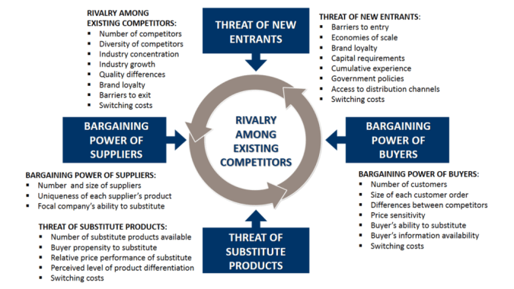
Porter’s Five Forces Model

Slide 15
Porter’s Five Forces Model
The framework for the Five Forces Analysis consists of these competitive forces:
Industry rivalry (degree of competition among existing firms)—intense competition leads to reduced profit potential for companies in the same industry
Threat of substitutes (products or services)—availability of substitute products will limit your ability to raise prices
Bargaining power of buyers—powerful buyers have a significant impact on prices
Bargaining power of suppliers—powerful suppliers can demand premium prices and limit your profit
Barriers to entry (threat of new entrants)—act as a deterrent against new competitors

Slide 16
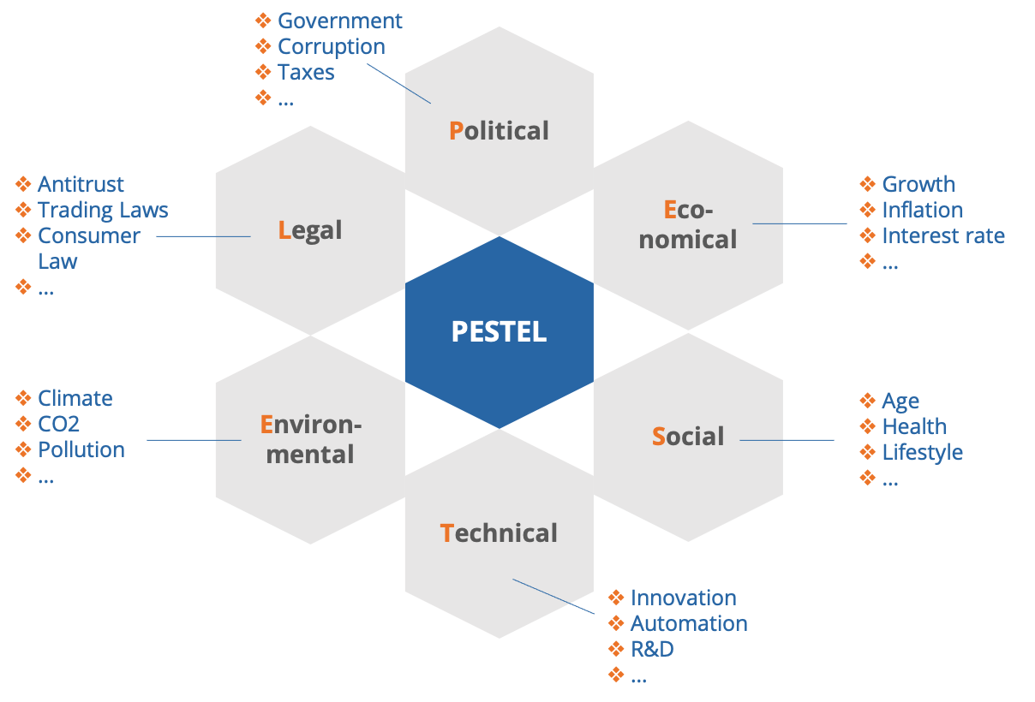
Company should know what is legal and what is not
This factor is all about how and what degree a govt. intervenes in the economy or certain industry.
Determinants of certain economic performance
Purchasing power of consumers
PESTLEG
Analysis
Exchange rate
Unemployment rate
Ecological Aspects. Increasing scarcity of raw materials, pressure by NGO
G
Demographics characteristics, norm, customs and values
Not Well being of our Planet
Income levels
P. Growth rate
Cultural barriers
Global
Global Market
Int. Political events
Global Integration
…
Understand the target customer and workforce and their willing ness
Pertain to innovations in technology and regulation surrounding tech.

Slide 17
Quantitative tools for planning:
There are some quantitative tools which aid managers in performing their planning functions. They are as follows:
1. PERT (Program Evaluation and Review Technique) or Network Technique: The PERT is used as a tool of project planning. It is a flow chart diagram that shows the sequence of activities need to complete a project and the time or cost associated with each activity. To apply the PERT it is essential to know about events, activities, slack time and critical path.
2. Break Even Analysis: Break Even (BE) Analysis is also called Cost-Volume Profit Analysis. It gives information about price and profit decision .The objective of BE analysis is to determine the quantity at which the product or services will generate enough revenue to start earning a profit.

Slide 18
3. Linear Programming: Linear Programming Technique is mostly useful for maximizing an objective such as profit or minimizing an objective such as cost. Under limited resources, what combination of variables gives the optimal solution (i.e., in maximizing profit or minimizing costs) is identified through this technique. It includes maximizing production, minimizing distribution cost and determining optimal inventory level.
4. Gant Chart: Gant Chart is another very useful tool for planning and monitoring project activities. It has a X-axis and Y-axis. On the horizontal axis, the duration of project in days or weeks is shown. On the vertical axis each individual activity is shown. A bar is then drawn for each activity that shows the beginning and ending times of different stages in the process. This enables the manager to monitor progress and deviation from the plan at a glance.

Slide 19
5. Forecasting: Forecasts are prediction, projections or estimates of future situation. It is primarily concerned with trying to reduce the uncertainty that exists about some part of the future. In the forecasting techniques, the role of information collected from different sources is very significant. Wrong information may lead to wrong forecast. The number of tools is available for quantitative forecasting. They are;
Time Series Analysis: Under this technique past information related to sales volume are used to predict the future demand of the product. The assumption of time series analysis is that the future will reflect the past. This method is especially suited for long range forecasting.
Projection or trend method: It involves the plotting of the figures for the past several years and stretching of the line. This extrapolation gives the figure for the coming years.
Regression analysis: Under this technique linear equation is used to interpret the relation between variables and forecasting the relation between independent and dependent variables.

